Slide 1

A Short History of 80 years of Achievement and
Thought Leadership by the United Nations

Slide 2
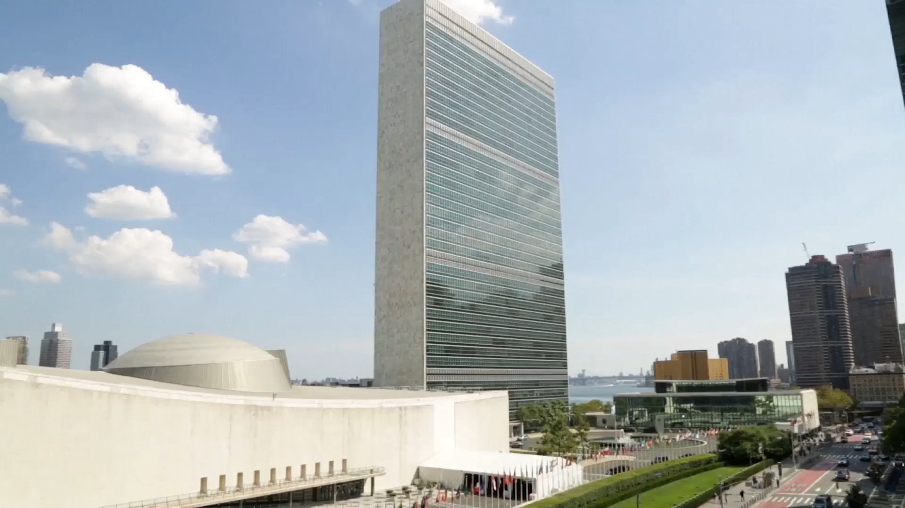
Notes:
The UN Headquarters Building in New York

Slide 3
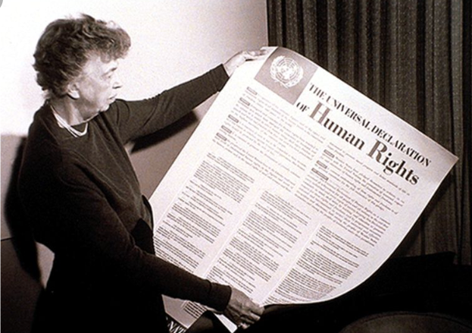
The Universal Declaration
of
Human Rights
Notes:
[<-CLICK->] First – the Universal Declaration of Human Rights. [<-CLICK->] Eleanor Roosevelt, widow of US President, Franklin D Roosevelt was the Chair of the Commission that drew it up – and was the driving force behind getting it signed on December 10th 1948.

Slide 4
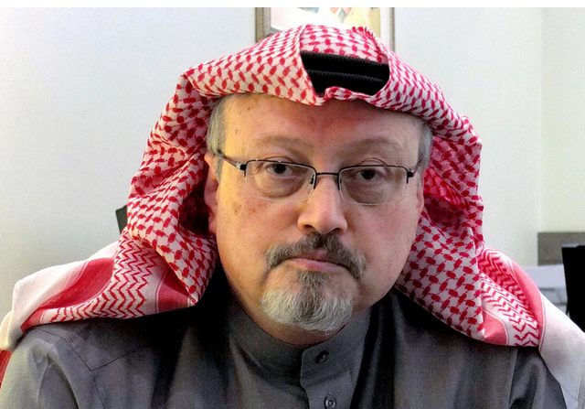
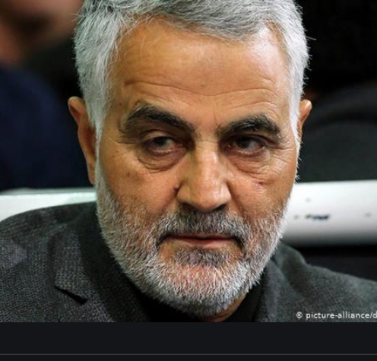
Notes:
Jamal Kashoggi and an Iranian General – both killed by governments which are the only institutions on earth that reserve the right to kill people in pursuit of their goals. Their deaths show we still have a long way to go to achieve Universal Human Rights

Slide 5
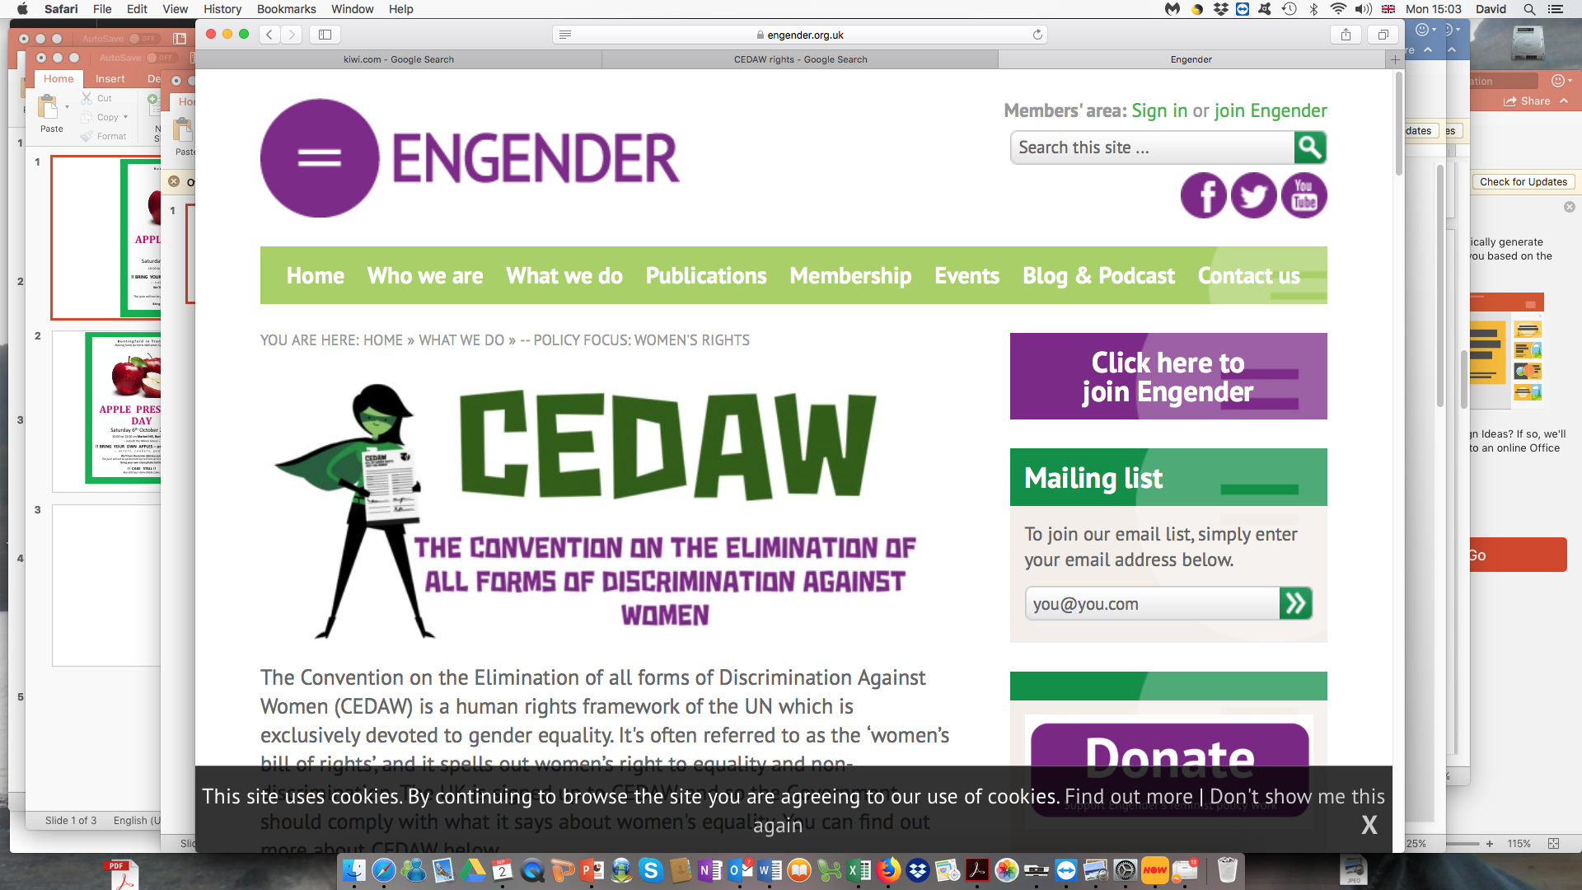
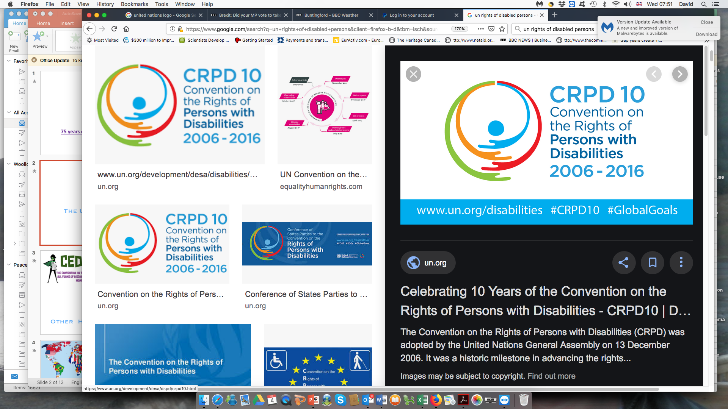
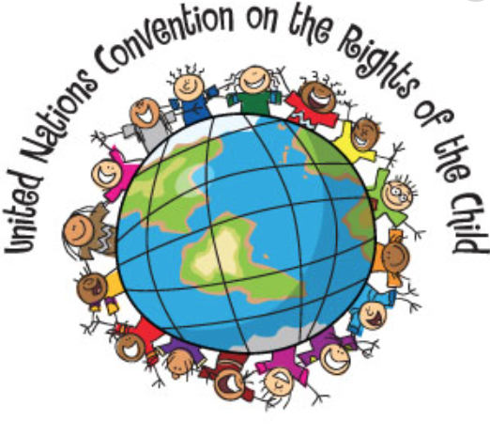
Convention on Rights of Persons with Disabilities
Other Human Rights Laws
Notes:
The Member Governments of the United Nations have agreed [<-CLICK->] many other Human Rights Laws or “Instruments” which are binding on those governments that sign and ratify them. Some of the main ones are [<-CLICK->] the Convention on the Elimination of all forms of discrimination against Women; [<-CLICK->] The Convention on the Rights of the Child; and [<-CLICK->] the Convention on the Rights of persons with disabilities – signed in March 2007. The UN’s Human Rights work continues today!

Slide 6
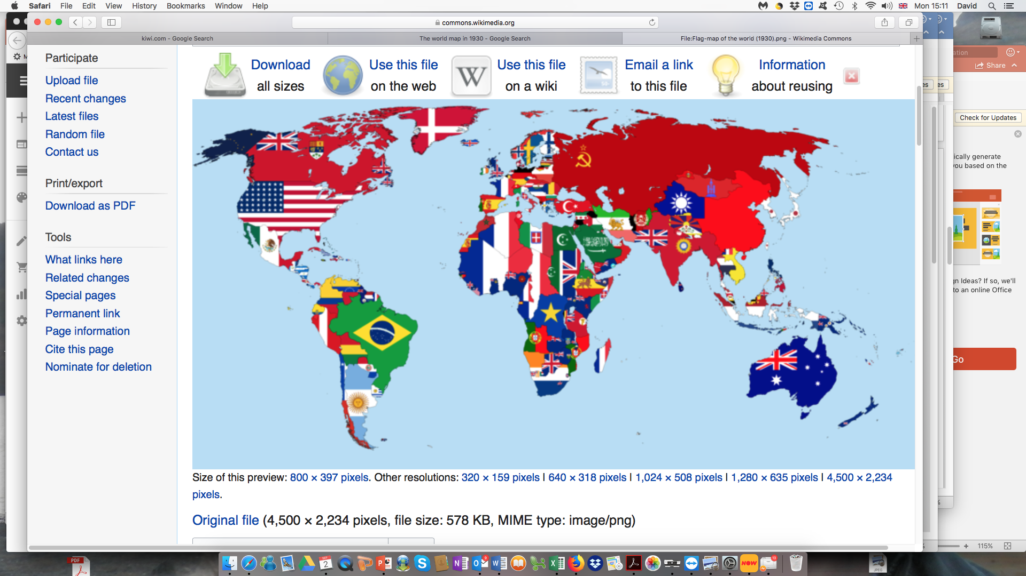
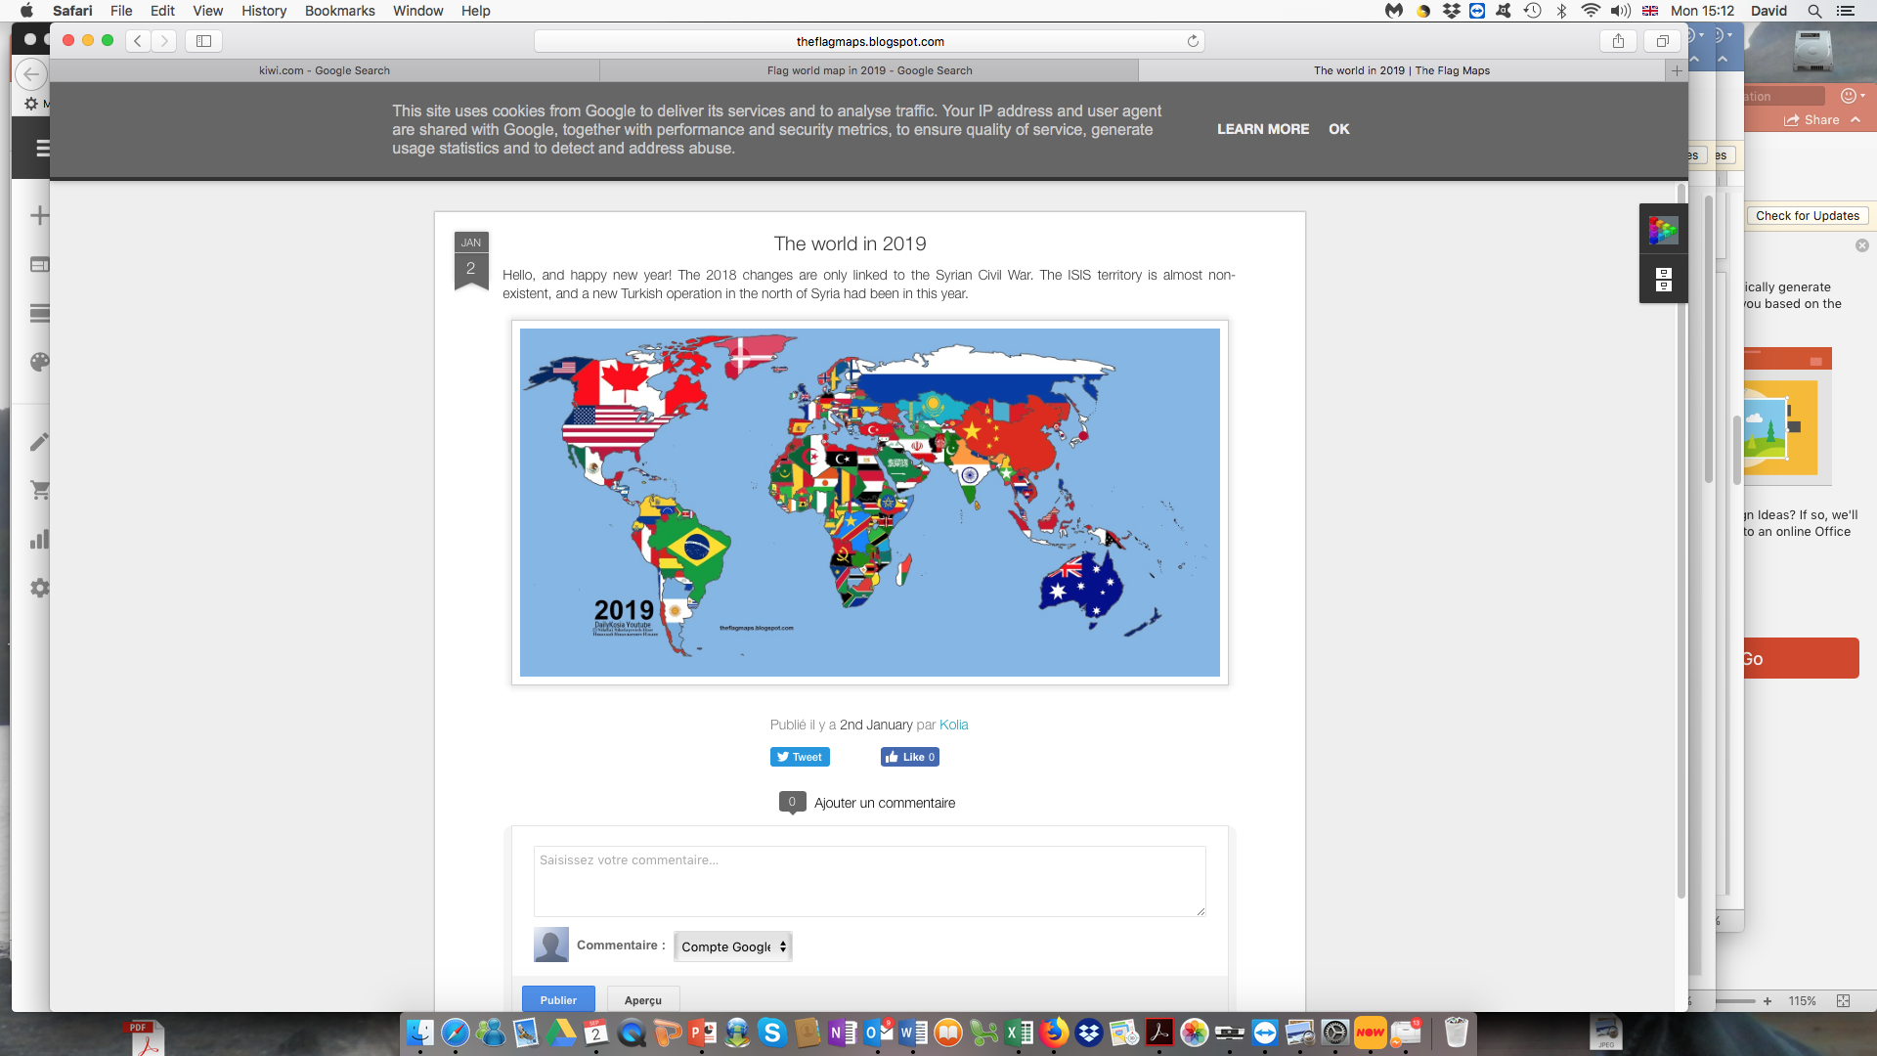
1 9 4 5
750 Million
2 0 1 9
2 Million
De-Colonisation
Notes:
[<-CLICK->] De-colonisation and the elimination of empires was another great founding idea of the UN – pushed by US President Franklin Roosevelt – who got Winston Churchill, the leader of the great British Empire and himself a great believer in Empire – to agree to it. And the UN has been massively successful in its de-colonisation efforts: [<-CLICK->] [<-CLICK->] in 1945, when it was born – 750 million people lived in countries controlled by imperial powers – chiefly France, the UK, the Netherlands, Belgium and Germany. [<-CLICK->] [<-CLICK->] Today, only 2 million do.

Slide 7
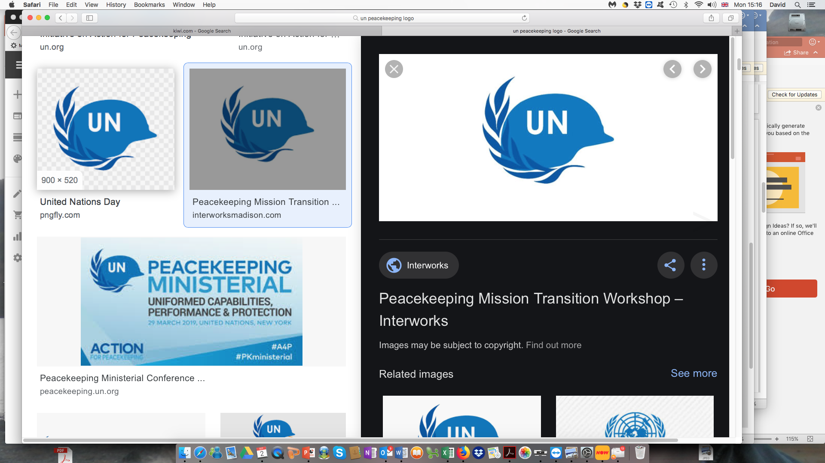
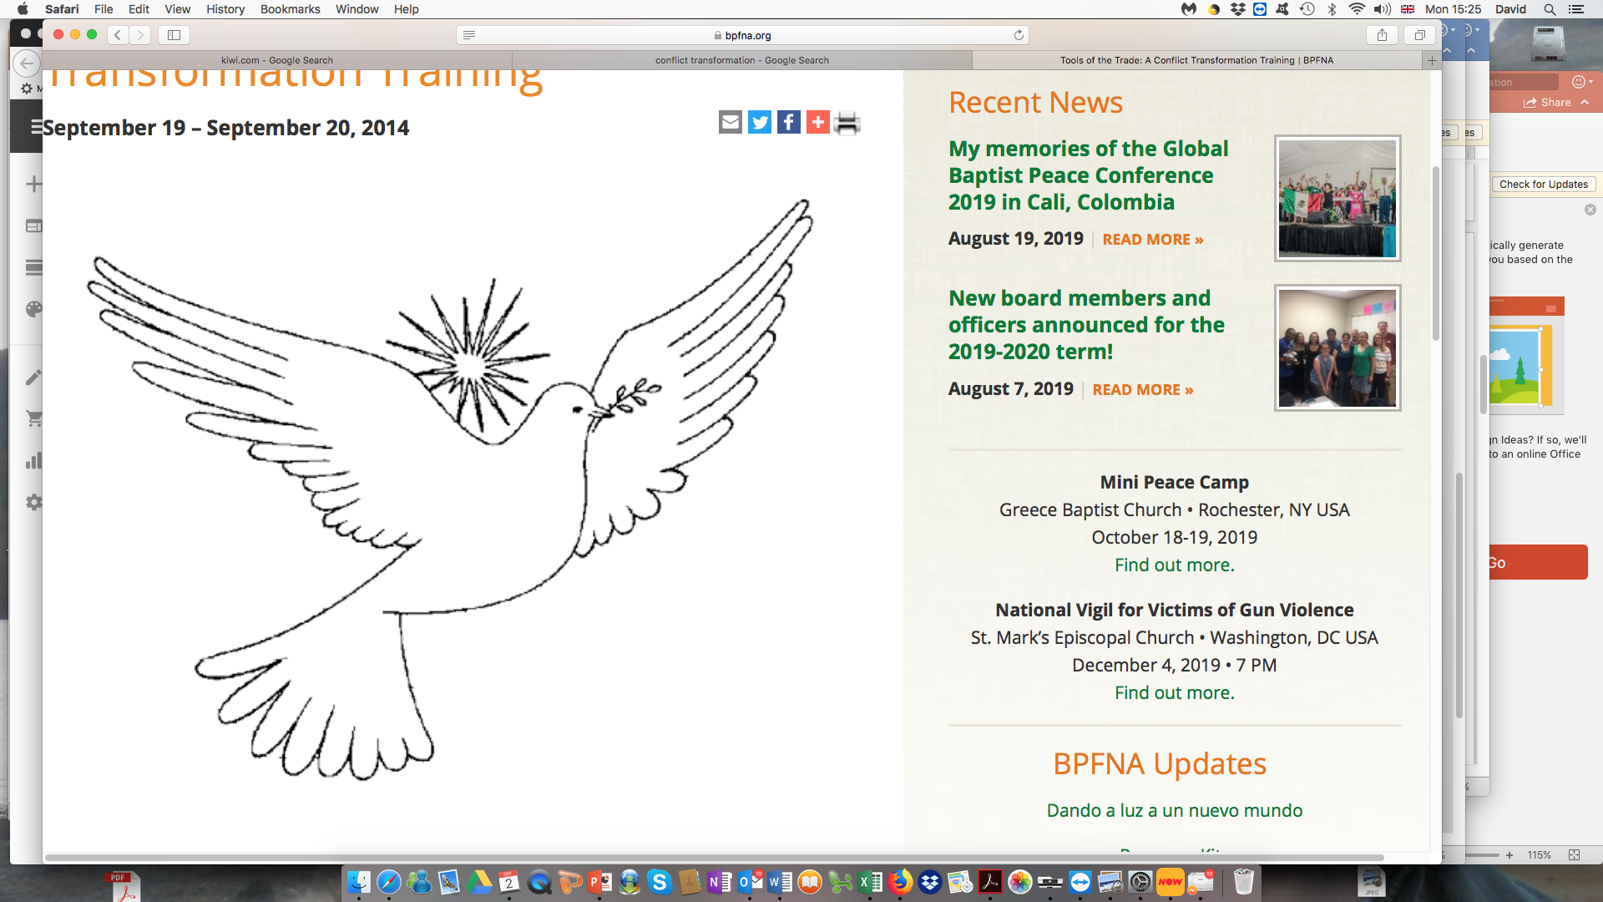
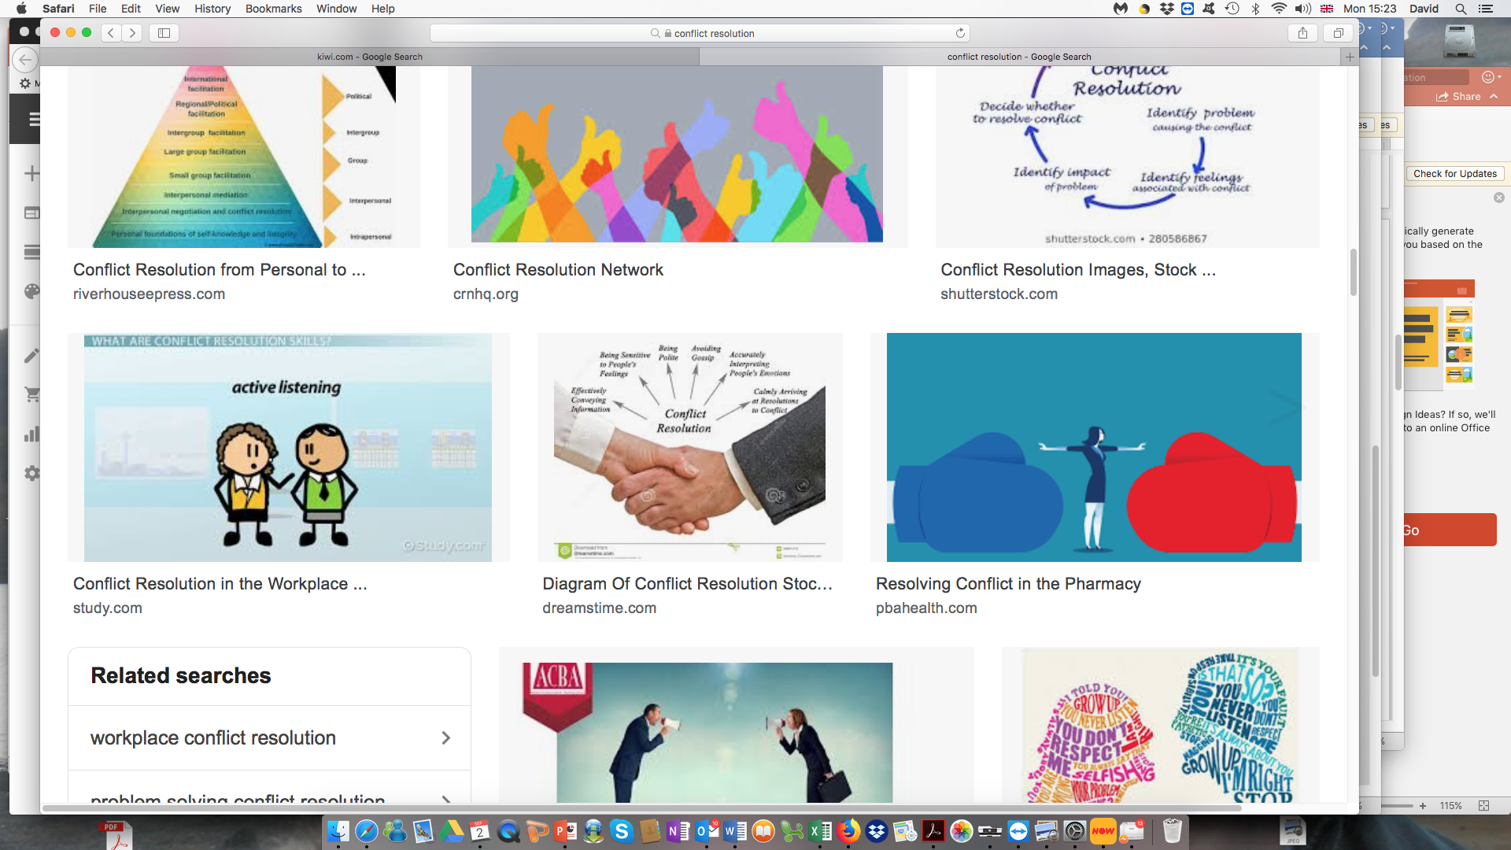
Conflict Transformation
UN Peace Keeping
UN Peace-making
Uniting Nations for Peace
Notes:
The UN has maintained its focus on “saving humanity from the scourge of war” – by becoming the centre for Peace-making in our world. It developed the idea of Peace-keeping [<-CLICK->] [<-CLICK->] – and today, there are over 100,000 UN Peace Keeping Soldiers at work in 14 peace-keeping programmes around our world. It also provides a focus for [<-CLICK->] [<-CLICK->] peace negotiations around the world and promotes the idea of [<-CLICK->] [<-CLICK->] conflict transformation. The UN itself, its staff and its agencies have won the Nobel Peace Prize 11 times in its first 75 years.

Slide 8
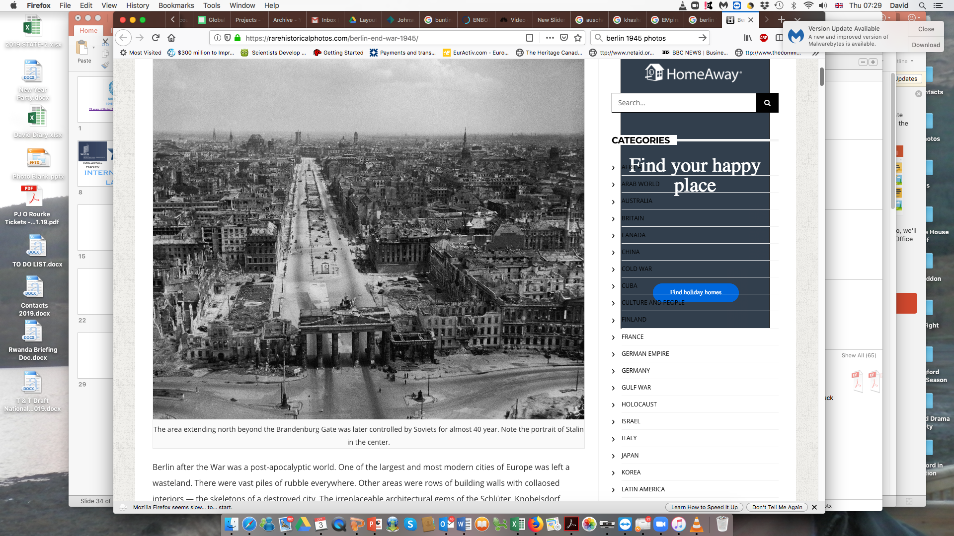
Notes:
Berlin in 1945 – showing the devastation war inflicts on once great human settlements; Grozny, Mariupol and Gaza look much like this after their wars

Slide 9
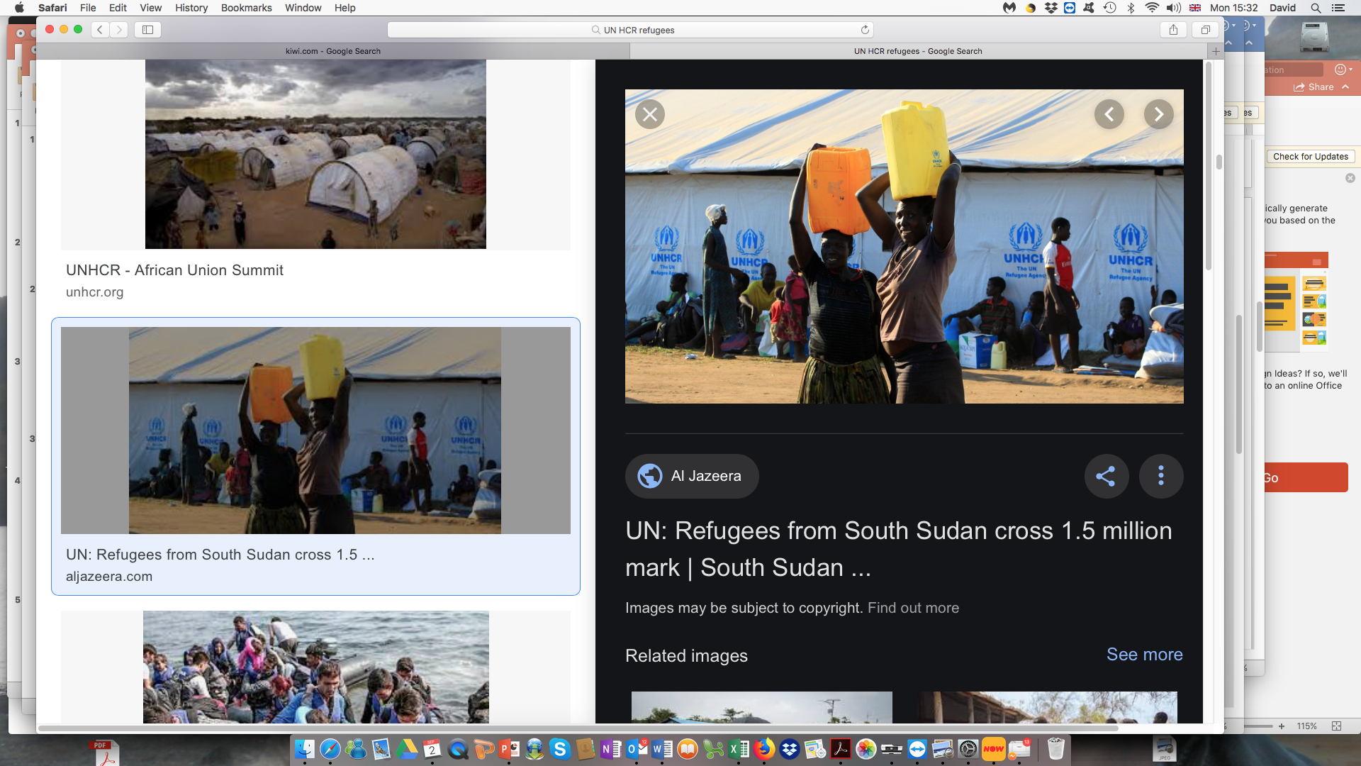
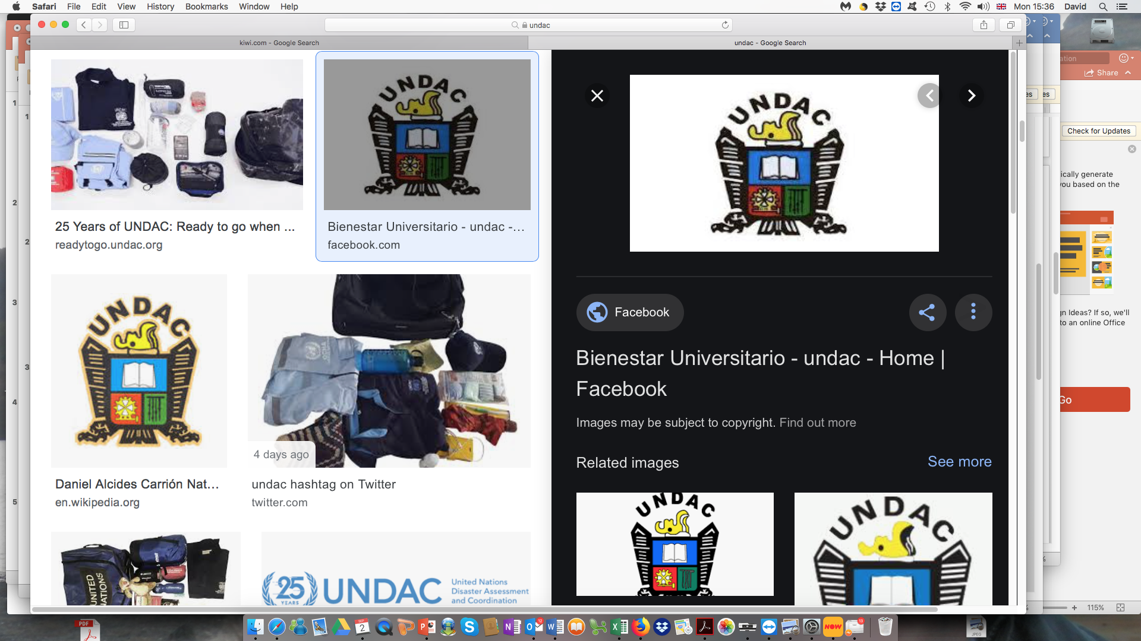
Care for Disaster Victims
Care for Refugees
CARE AGENCIES
Notes:
The UN believes in the duty of all governments [<-CLICK->] to care for its poorest citizens. Therefore, it has set up agencies to promote development and care for refugees - [<-CLICK->] [<-CLICK->] and people caught up in natural disasters. [<-CLICK->][<-CLICK->]

Slide 10
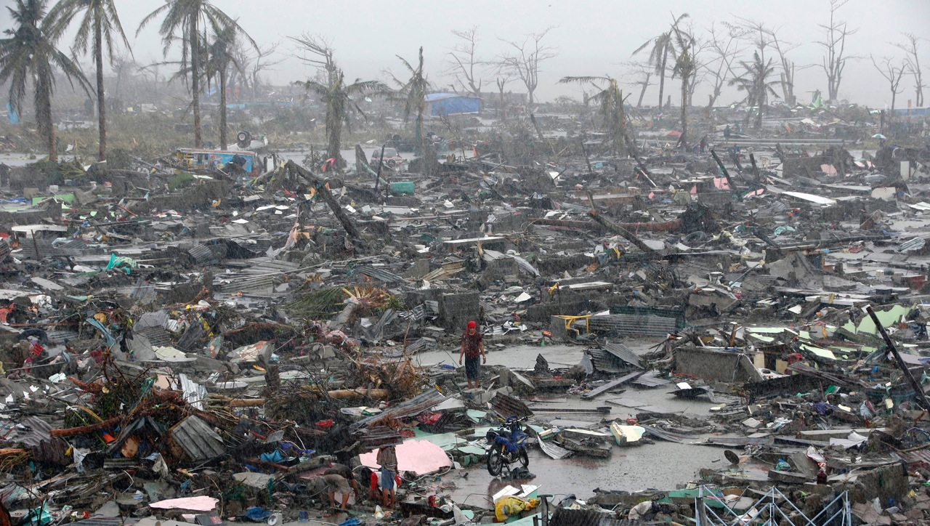
© 2013 Reuters/Erik De Castro
Notes:
The devastation caused by a tropical storm in the Philippines, which generated millions of climate refugees.
DESCRIPTION: Photo of a survivor amid the destruction after Typhoon Haiyan swept through Tacloban City, Philippines, November 10, 2013
ADDITIONAL TALKING POINTS: Typhoon Haiyan impacted approximately 16 million people and damaged or destroyed 1.1 million homes in the Philippines in November 2013.*
REFERENCES:
* United States Agency for International Development, “Typhoon Haiyan/Yolanda Fact Sheet #22,” April 21, 2014. http://www.usaid.gov/haiyan/fy14/fs22

Slide 11
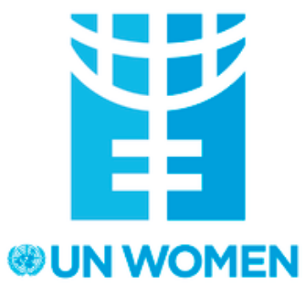
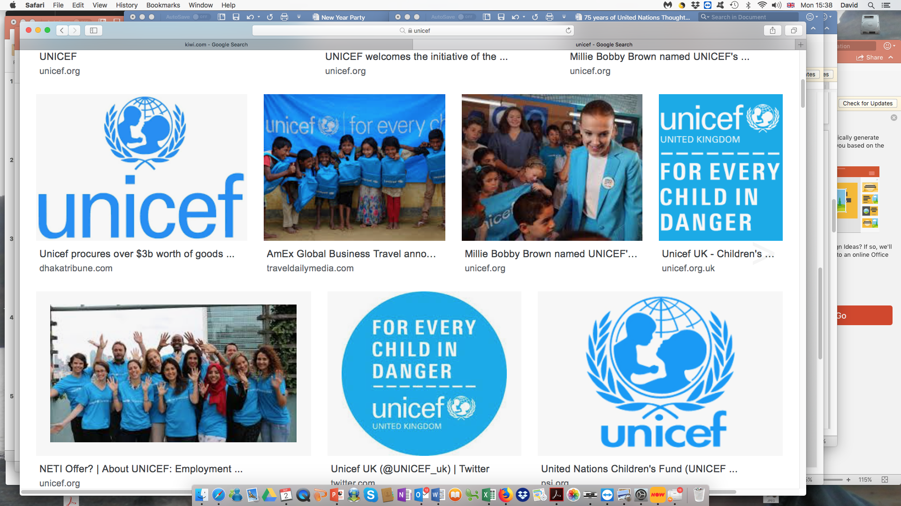
The Idea of Women & Children FIRST
Notes:
[<-CLICK->] Perhaps the UN’s most famous Care agency is the one set up to care for children: [<-CLICK->] UNICEF – which stands for “United Nations International Children’s Emergency Fund” – as it was set up originally to look after children, especially orphans, after the Second World War. Another famous one is [<-CLICK->] UN Women - set up to promote gender equality and the empowerment of women.

Slide 12
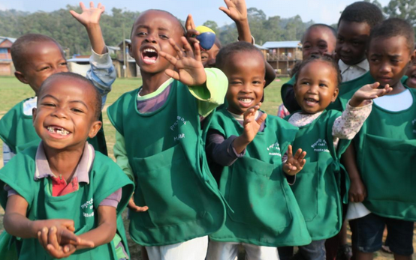
Notes:
UNICEF’s beneficiaries

Slide 13
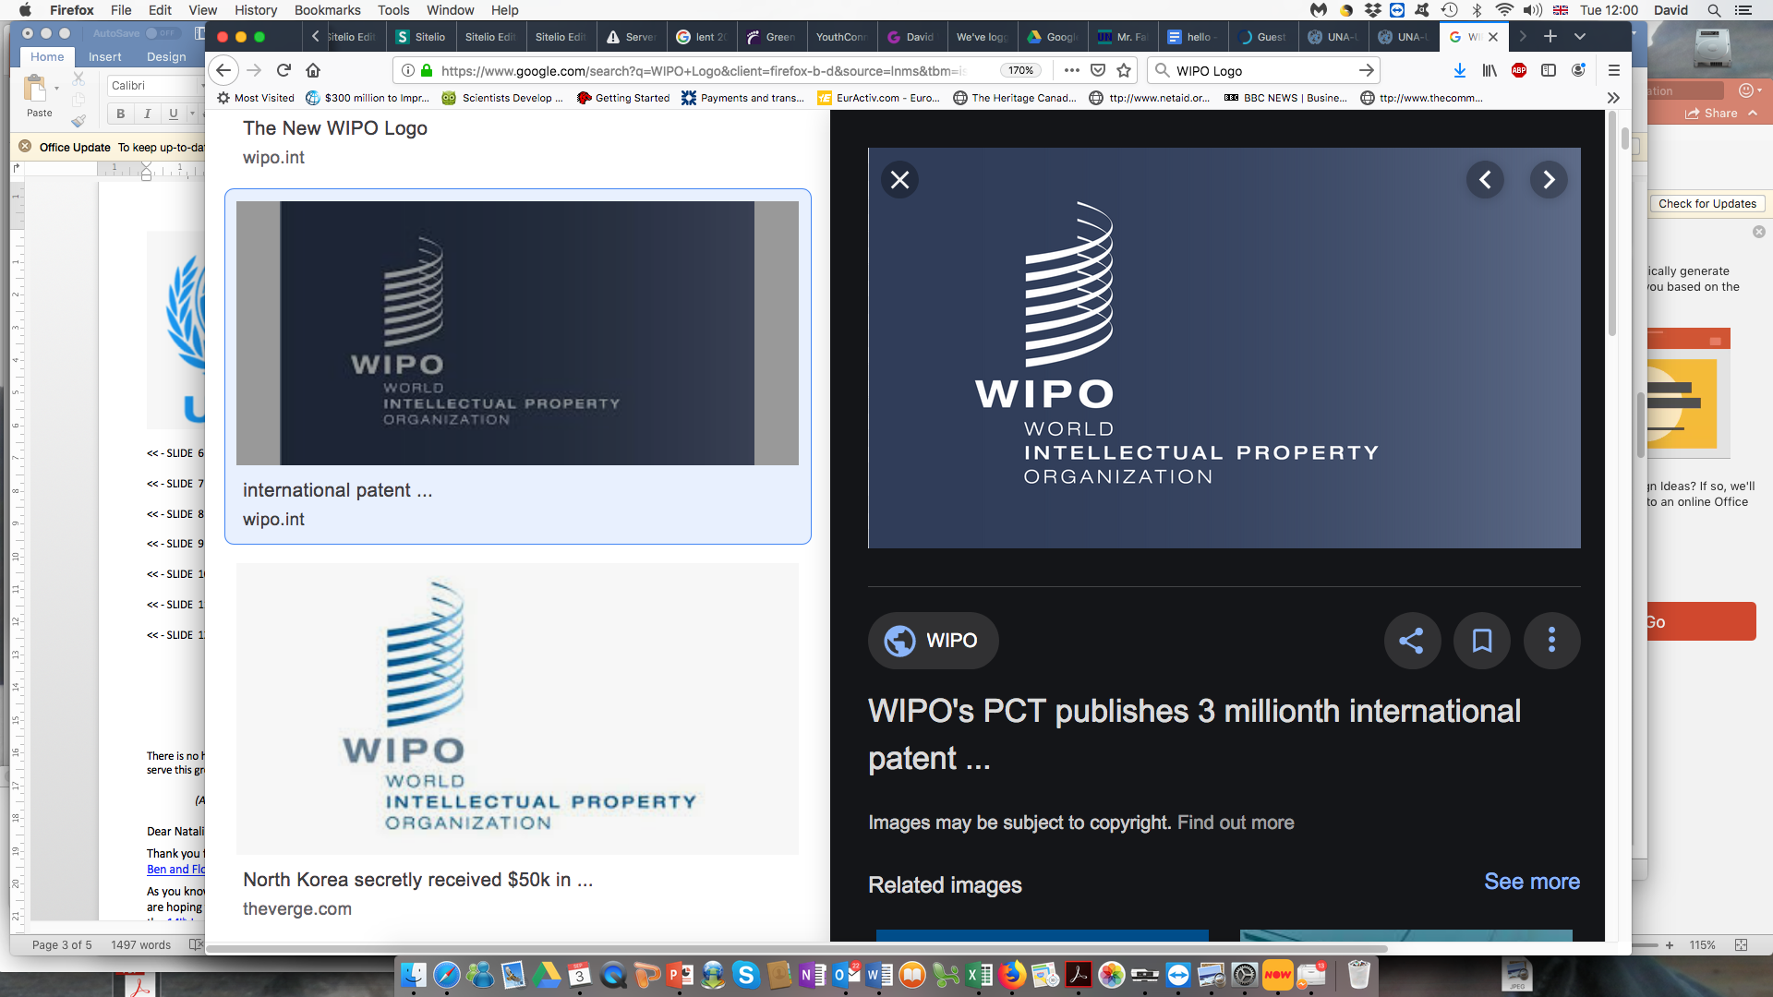
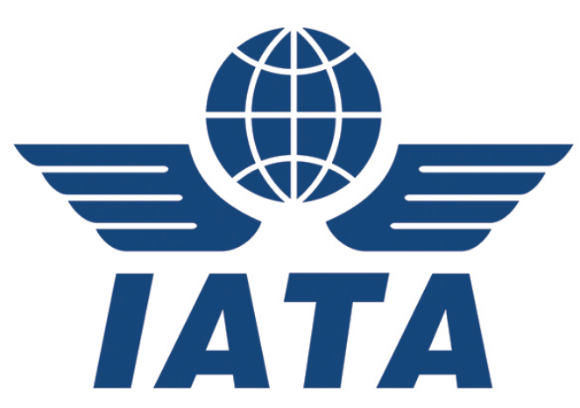
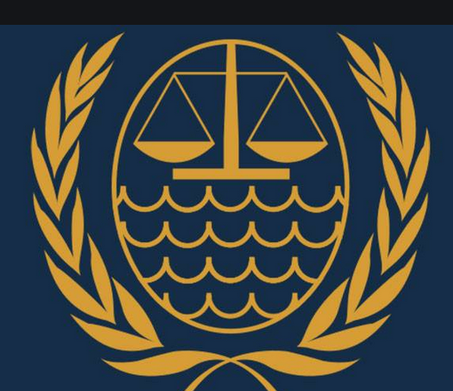
Intellectual Property
Law of
The Sea
Air Travel
INTERNATIONAL LAWS
Notes:
In it’s first 75 years, the UN has negotiated many [<-CLICK->] International Laws & Regulations including laws [<-CLICK->] [<-CLICK->] to protect intellectual property – music, literature, everything that can be copyrighted is now protected worldwide by UN agreement; [<-CLICK->] [<-CLICK->] the Law of the Sea: who owns what on the sea-bed and who can catch fish where; [<-CLICK->] [<-CLICK->] and the Law of the air – ways to police the skies, organising air lanes and setting the regulations – the traffic lights in the sky if you like – about who can fly where. Without these laws, planes and ships would be crashing into each other all the time.

Slide 14
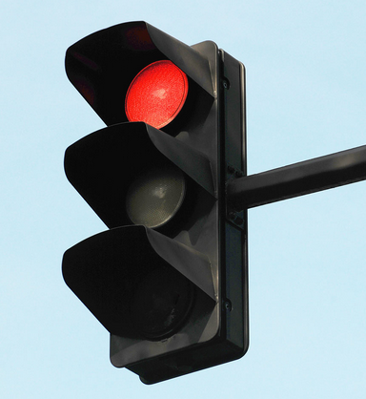
Notes:
Our World – and perhaps even our World’s Governments – need to obey global stop lights

Slide 15
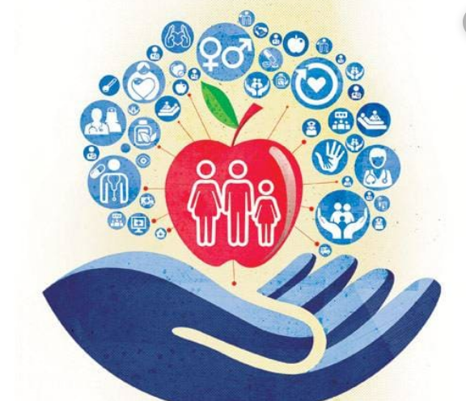

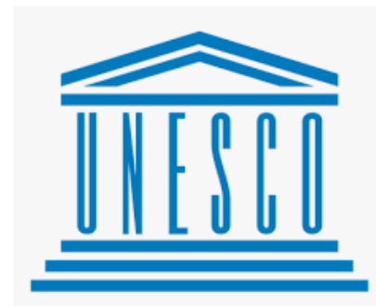
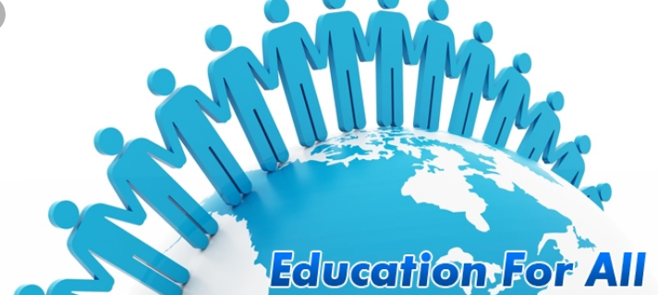
Food for All
Health for All
LEAVE NO ONE BEHIND !
Notes:
A lot of people think that the UN is just a talking shop – where diplomats are paid a lot of money to push paper around: NOT true! After the Universal Declaration of Human Rights agreed the right [<-CLICK->] of every one on earth to health, food and education, it set up agencies to provide [<-CLICK->] [<-CLICK->] Health for All (the World Health Organisation – WHO); [<-CLICK->] [<-CLICK->] Food for all(The Food and Agriculture Organisation – FAO and the World Food Programme, both based in Rome, Italy) - and [<-CLICK->] Education for All which is driven by [<-CLICK->] UNESCO – the UN Education, Science and Cultural Organisation, based in Paris, France. “Leave No One Behind” is one of the UN’s most powerful slogans as it means: the United Nations serves EVERYONE – Every single Man, Woman and Child living on Planet Earth.

Slide 16
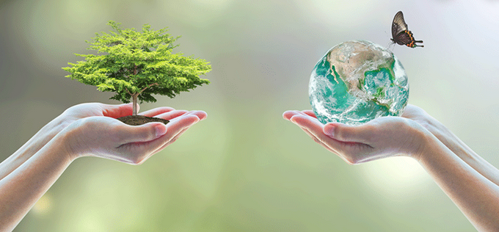
FIGHTING TO PROTECT THE ENVIRONMENT
I
Notes:
[<-CLICK->] The UN has led the fight to protect our world’s Natural Environment – to protect [<-CLICK->] all the plants and animals with whom we share this planet, and to stop the pollution of freshwater, sea, land & space;

Slide 17
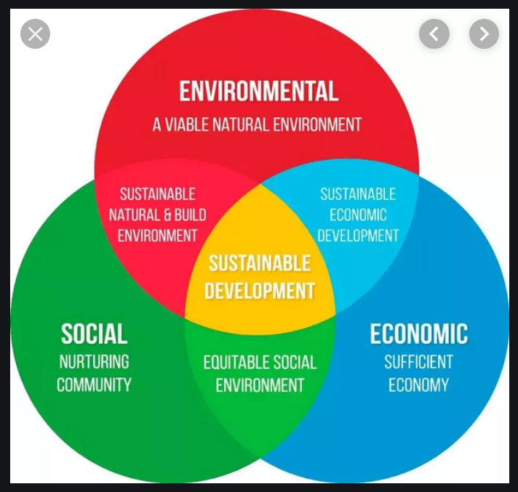
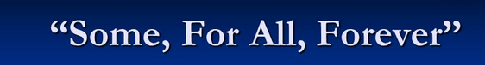
THE CONCEPT OF
SUSTAINABLE DEVELOPMENT
Notes:
In 1986, it developed [<-CLICK->] the idea of Sustainable Development: "… meeting the needs of the present without compromising the ability of future generations to meet their own needs." [<-CLICK->] The idea is to balance the needs of human beings with those of the environment and the economy. It’s a hard idea to get your head around – so we often use the 4-word slogan used at the South Africa summit on Sustainable Development: [<-CLICK->] ‘SOME - FOR ALL - FOREVER!”

Slide 18
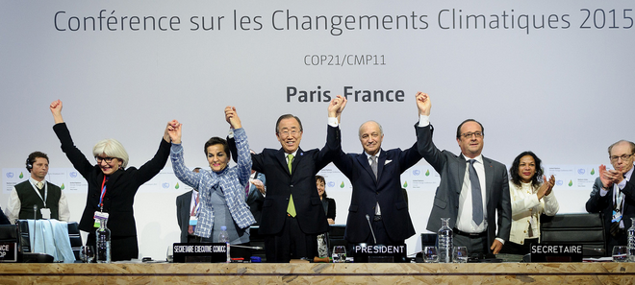
REVERSE CLIMATE CHANGE
Notes:
Perhaps most famously, the UN is leading the fight to stop and [<-CLICK->] reverse Climate Change. [<-CLICK->] In Paris, France – in December 2015 – it got 193 governments to agree to limit global warming and introduce their own plans to reduce their carbon emissions massively each year to meet their agreed targets.

Slide 19
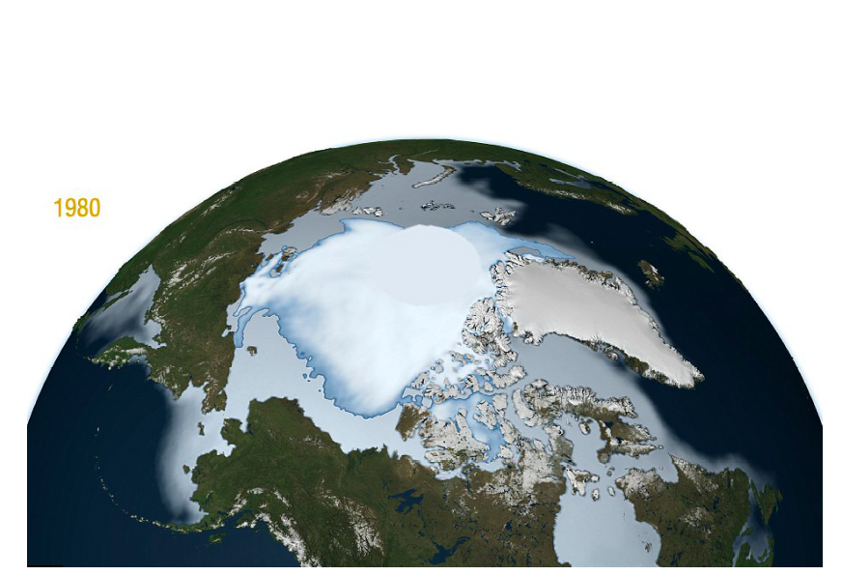
1980
Notes:
The Arctic Ice Cap in 1980

Slide 20
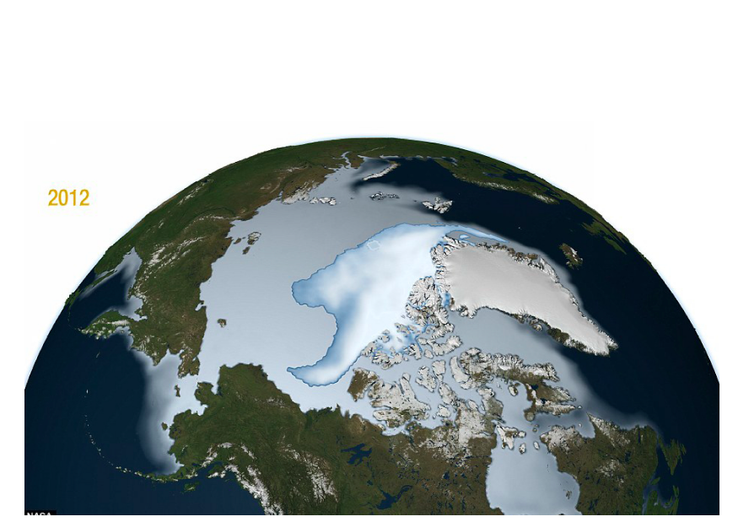
2018
Notes:
The Arctic Ice Cap in 2018. Most scientists agree: the Arctic Ice cap will disappear completely in summers before 2050; the volume of ice there is already a fraction of what it used to be. Similar meltings are happening in the Antarctic, Greenland and Siberia – where Russians are building new port cities to service polar shipping routes

Slide 21
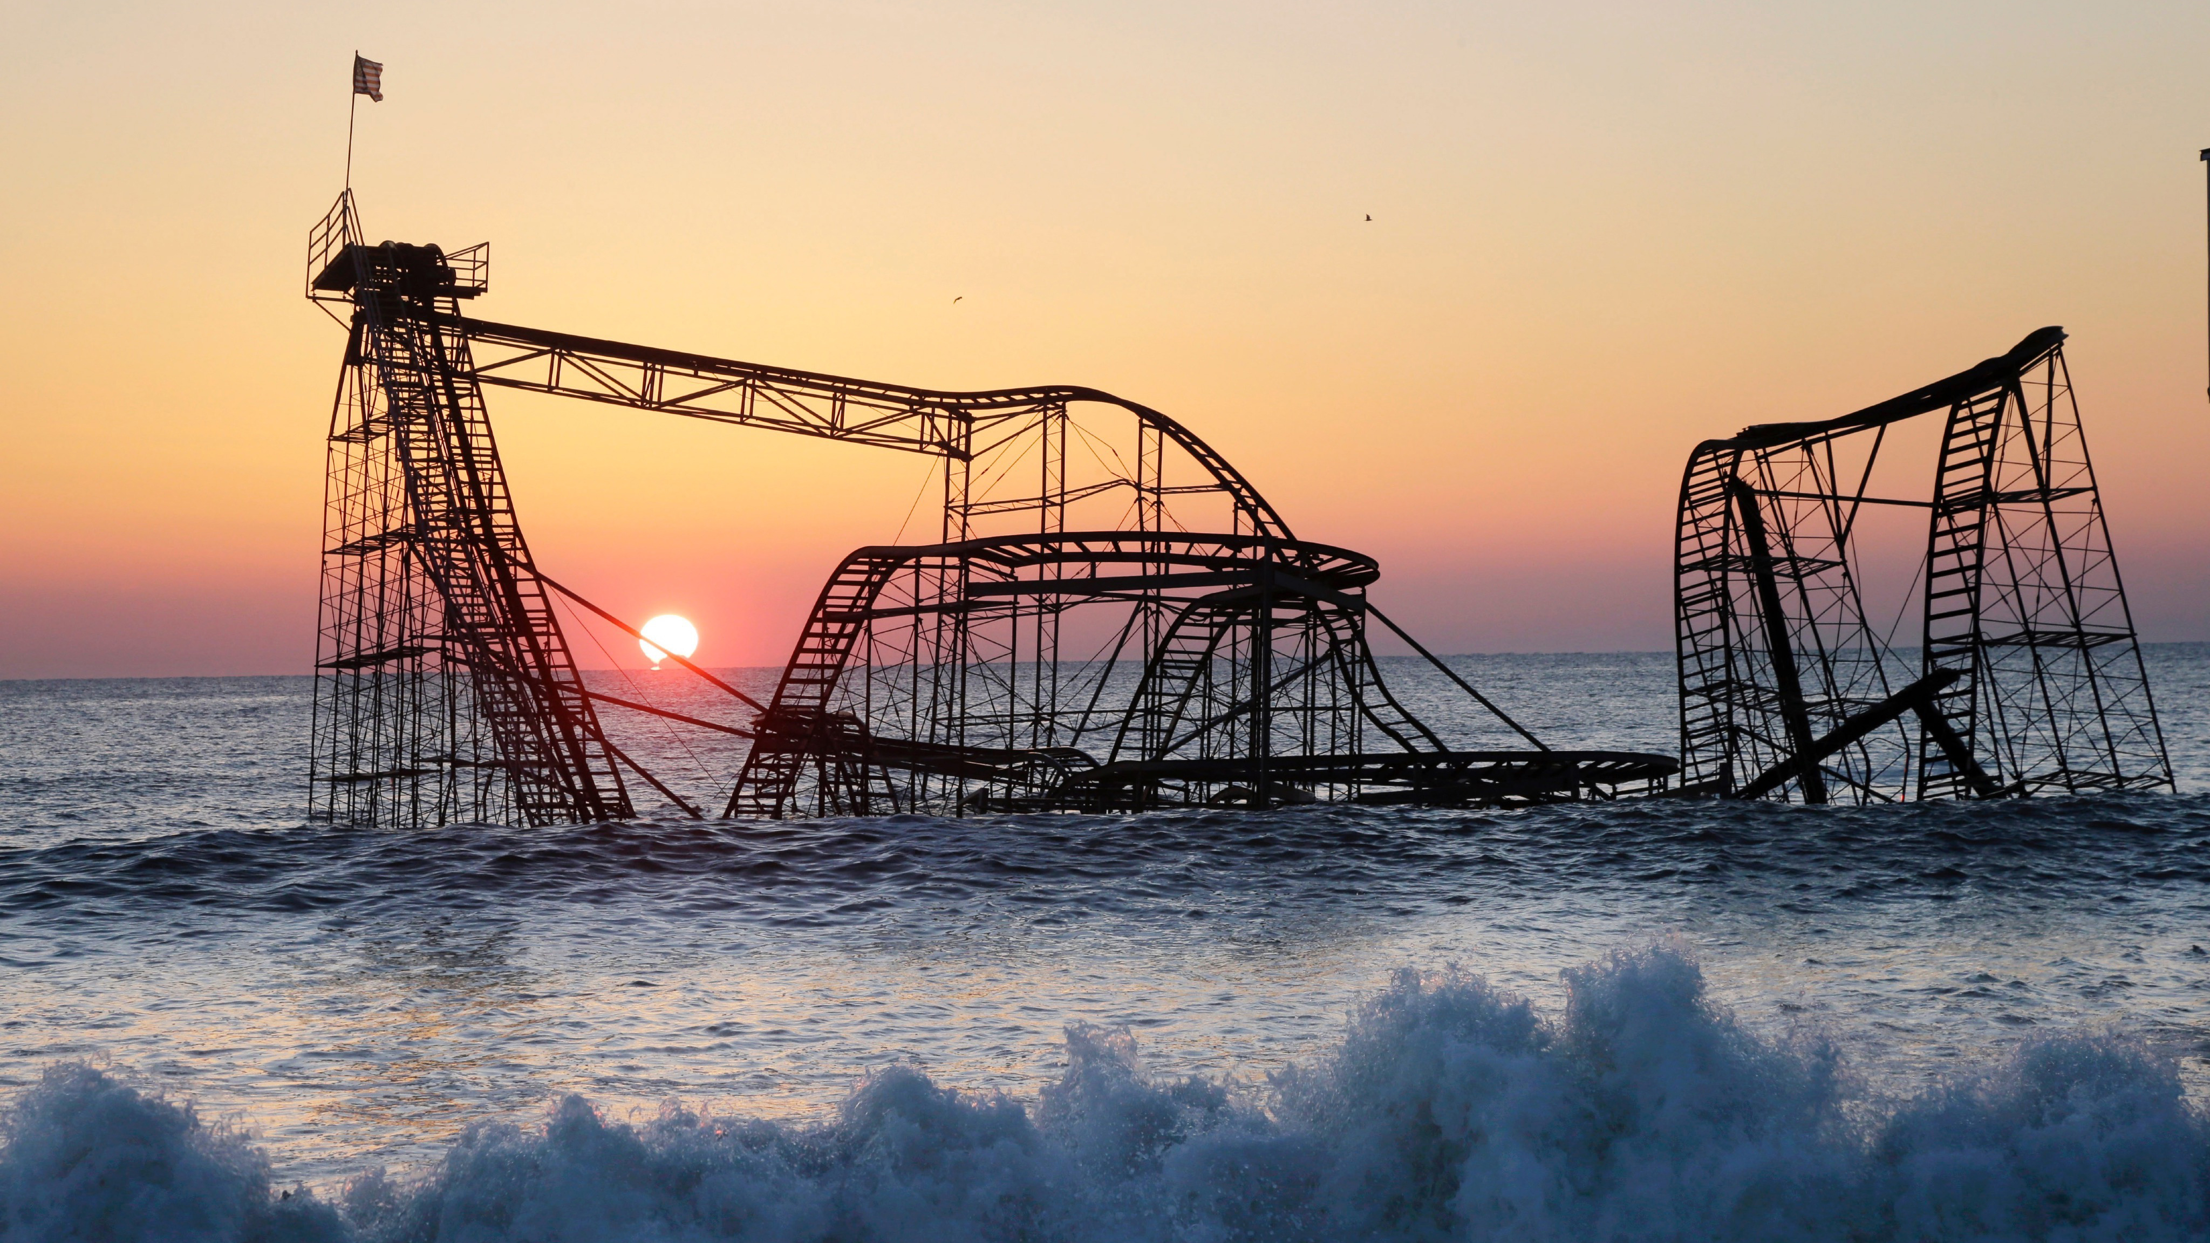
© 2013 AP Photo/Mel Evans
Notes:
Atlantic City Roller-Coaster after the devastation of Super Storm Sandy hit the coast of New Jersey in October 2012. It is called a “Super Storm” rather than just a hurricane because multiple weather systems converged around it causing a circle of impact 900 miles in diameter.

Slide 22
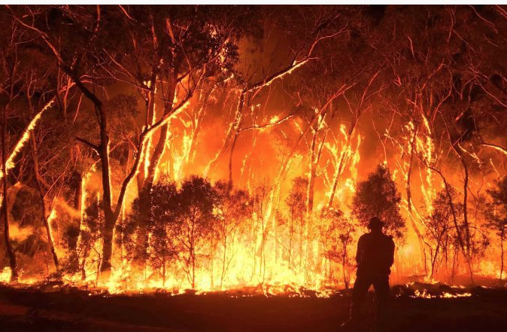
Notes:
Forest Fires in Australia caused the deaths of close to a billion animals and destroyed millions of acres of forest and vegetation

Slide 23
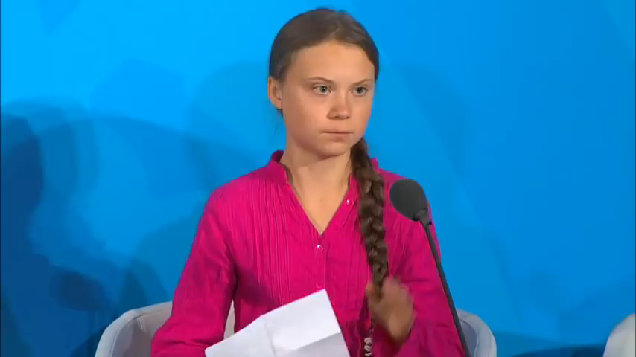

Slide 24
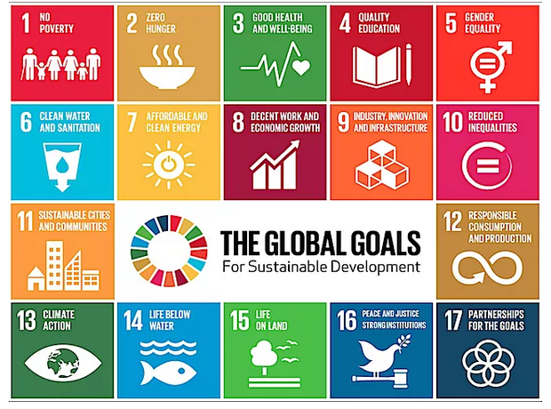
UN SUSTAINABLE DEVELOPMENT GOALS
Notes:
Also in 2015, the 193 Member Governments of the United Nations agreed [<-CLICK->] the 17 Sustainable Development Goals. [<-CLICK->] These include 169 targets for governments to meet by 2030 – or before - to eliminate absolute poverty, save the planet’s environment, deliver peace and justice and – that slogan again: “LEAVE NO ONE BEHIND!!” These goals form the basis of Peace Child International’s Vision 2030 programme – which looks at what the UN has achieved already in its first 75 years – and outlines the problems that the UN – and your whole generations – still have to solve! We hope you use the occasion of the UN’s 75th Birthday to learn about the Global Challenges that your generation faces and that you will get stuck in NOW – while you are young – to start thinking about how you are going to solve them!

Slide 25
What about the Next 80 Years?
How will your Generation Re-invent the UN?
Notes:
Any Questions?? How are your generation going to re-invent the United Nations??

